Slide 1
Master-Thesis Methodical Approach for Analyzing Process Variables and Optimizing Boundary Conditions in Multi-Axis Robot Programs
Status Update: 4 weeks left
14.01.2024 – 04.02.2024
Jan Nalivaika

Slide 2
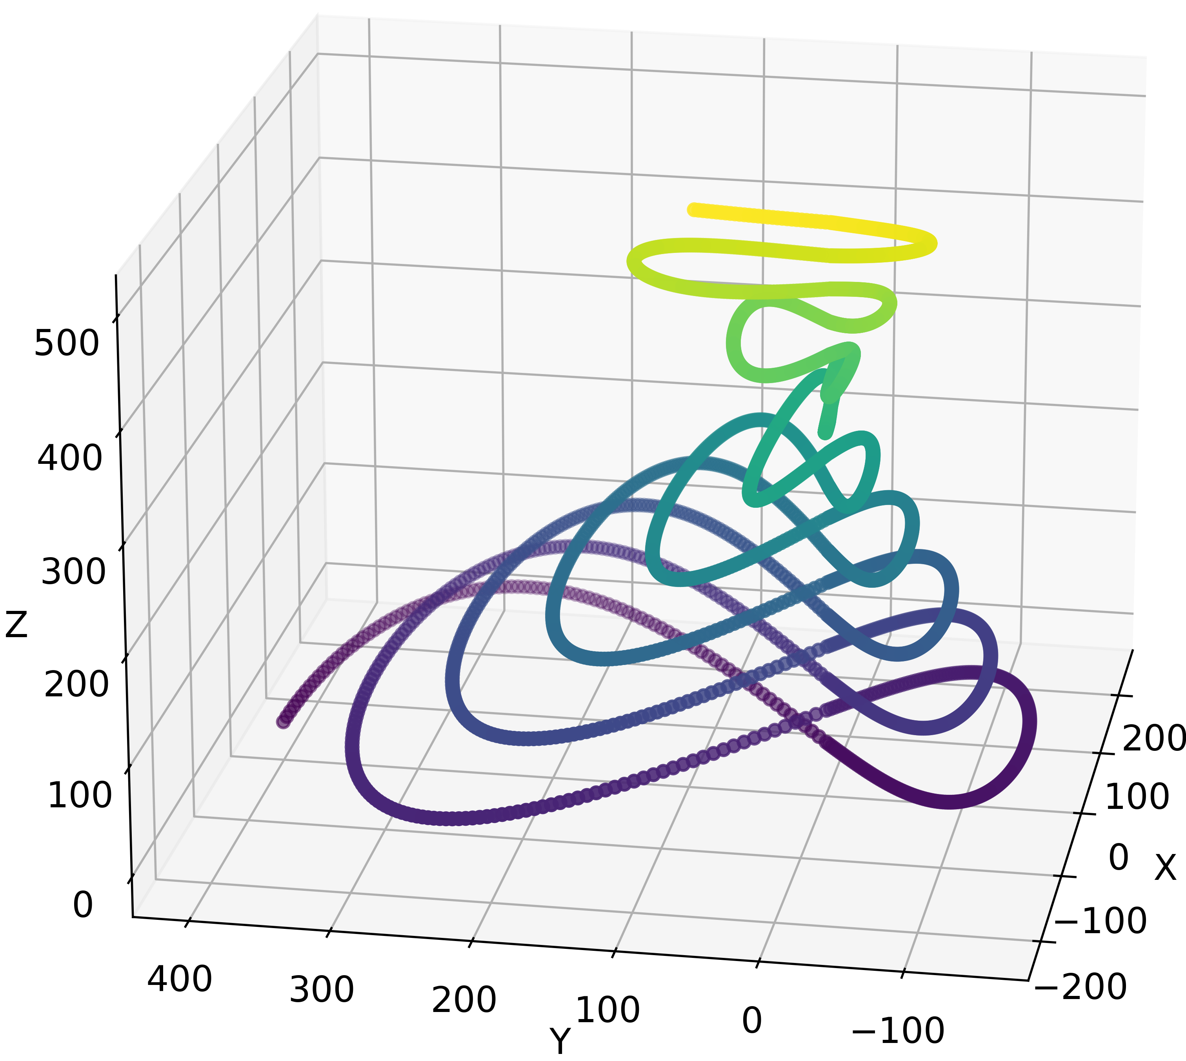
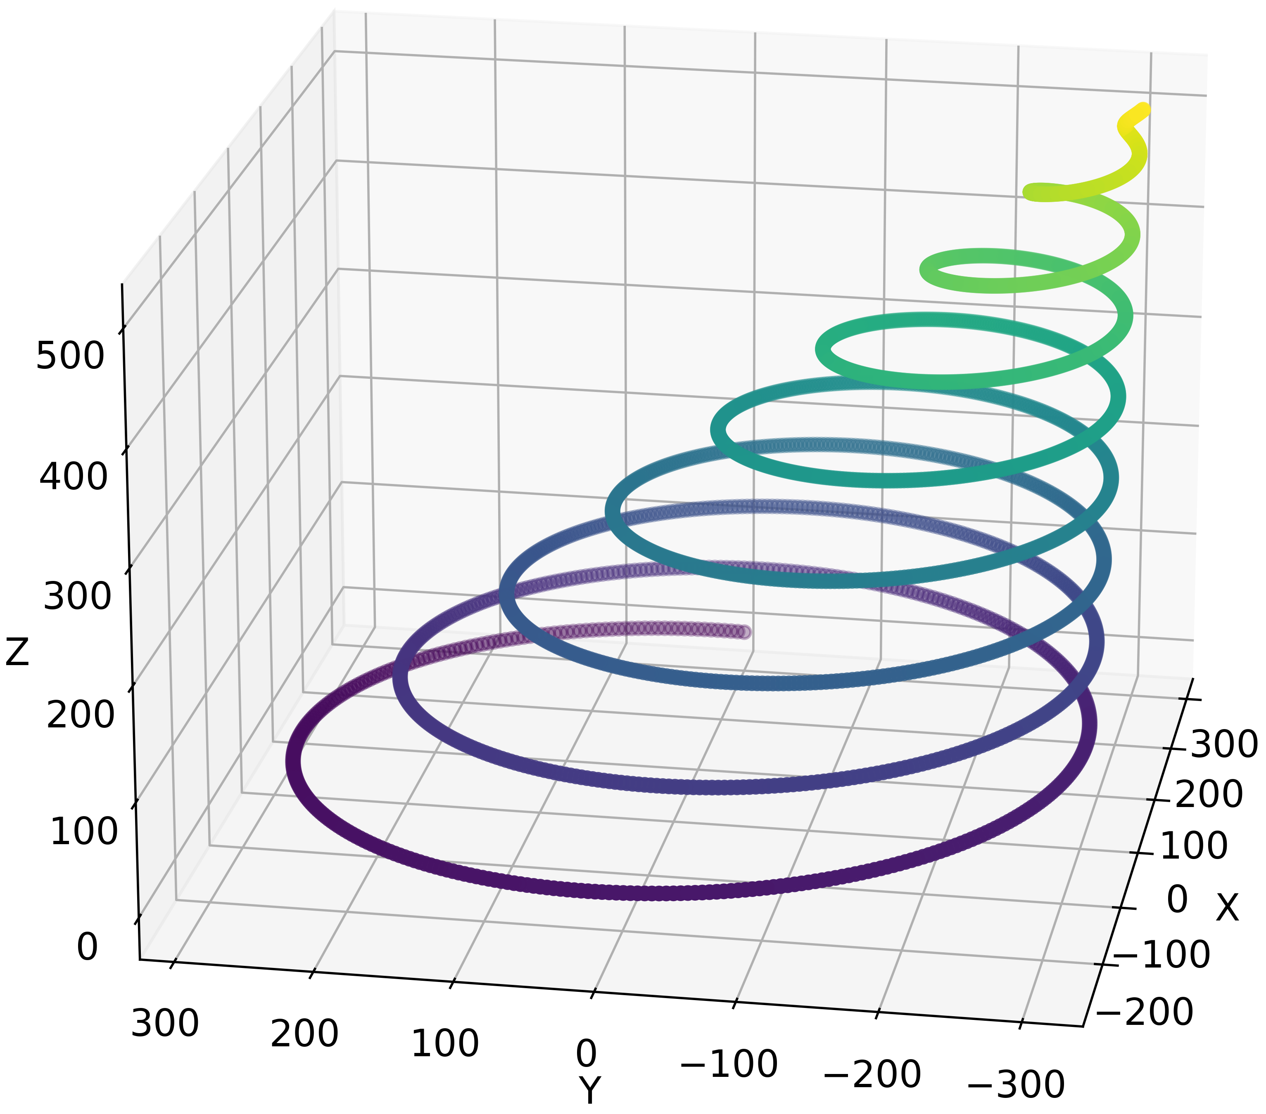
Show PDF

Slide 3
To Do
Nochmal Gewichtung verdeutlichen
Statndard Abweichung in Outlook
Marius paper schreiben fragen
(Defense nochmal besprechen)

Slide 4
Future planning
DATE: Ludwig Marius Jan
02.02 PDF update (Paper start ?) ☺
09.02 (submit slides) ☺
16.02 ☺
23.02 Last possible Changes in PDF ☺
04.03 Defense ?? (16-17) (on location) ☺

Slide 5
Contact
Jan Nalivaika (TUM) Student Otto-Hahn-Ring 6
81739 Munich, Germany
Phone +49 163 7180148
E-mail jan.nalivaika.ext@siemens.com nalivaika@outlook.de
Marius Breuer (Siemens AG)
Supervisor Otto-Hahn-Ring 6
81739 Munich, Germany
Phone +49 (172) 8396287
E-mail marius.breuer@siemens.com
Ludwig Siebert (TUM-IBW)
Supervisor Boltzmannstr. 15
85748 Garching at Munich
Phone +49 (89) 289 – 15578
E-mail ludwig.siebert@iwb.tum.de

Slide 6
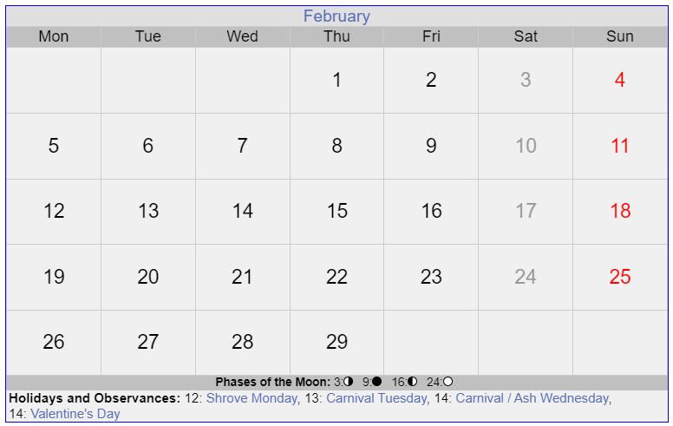

Slide 7
